Slide 1



IDBE Geotech Meeting
Activity proposal for IDBE Geotech
Date: 21 June, 2021
Speaker: Mickaël BEAUFILS (BRGM)

Slide 2
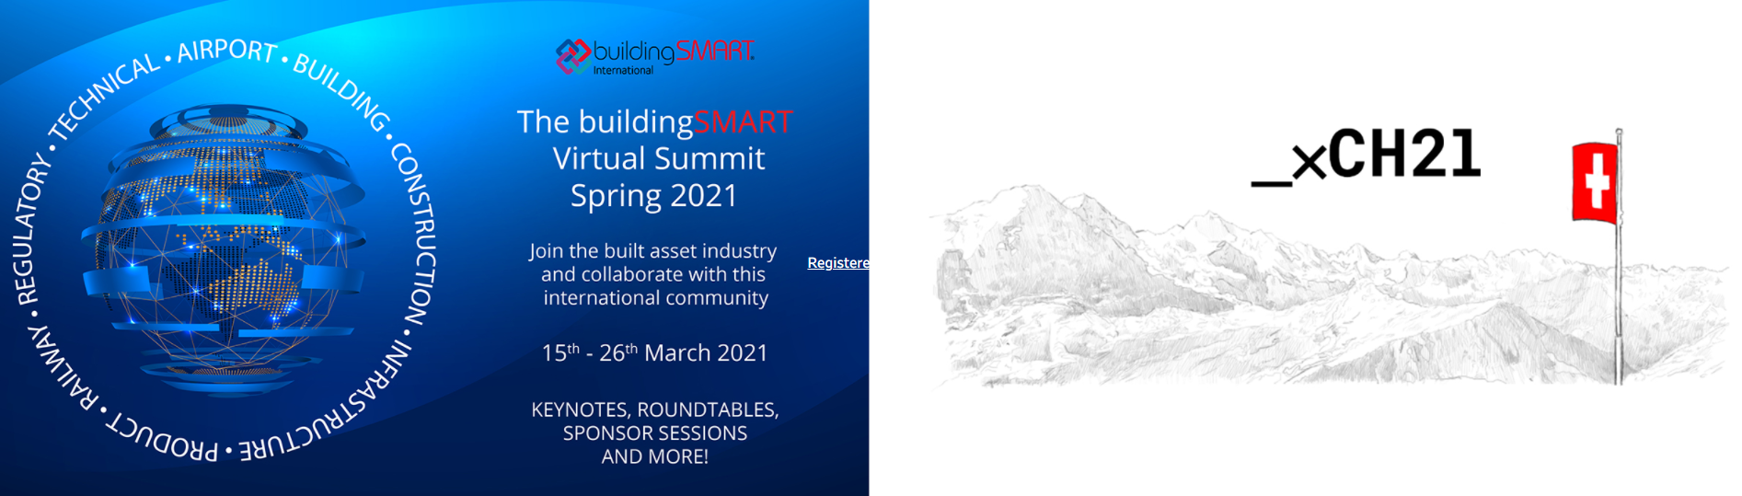
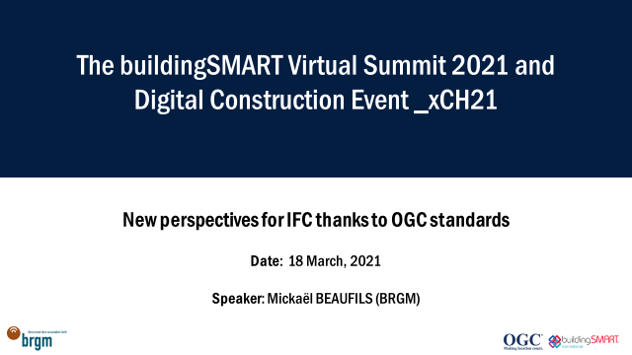
buildingSmart International Summit March’21
https://summit.buildingsmart.org/series/agenda52/schedule
Infrastructure Room Session 1
Infrastructure Room 'Coffee Break' Session 1
Thursday 18th

Slide 3
Philosophy / Rationale
Take benefits of past standardization efforts
Reuse and extend existing data models and vocabularies
Encourage early data standardization and facilitate reuse of these data
Most geoscience data are not produced in a BIM software
« Single Source of Truth » principle
Data access and edit vs. duplication
Update consideration
Commit principle vs. Whole model exchange

Slide 4

Today: What IFC enabled to do so far?
BIM Software A
BIM
Software B
IFC file
Agreed objects / concepts
Agreed properties
Agreed vocabularies
Model sharing via Import/Export
Addressing more and more topics

Slide 5
Tomorrow: How BIM is (generally) foreseen in the future / Digital Twin
BIM Software A
Infrastructure
Digital Twin
BIM
Software B
Other software C
Other software D
CDE / SSOT
Concurrent accesses
Digital continuity
Data up to date

Slide 6
Building tomorrow: What OGC standards can already enable to do
BIM Software A
BIM Software B
IFC file
Data
Data
API
Vocabulary registry
API
Access non BIM oriented data
As demonstrated in Beijing bSI Summit

Slide 7
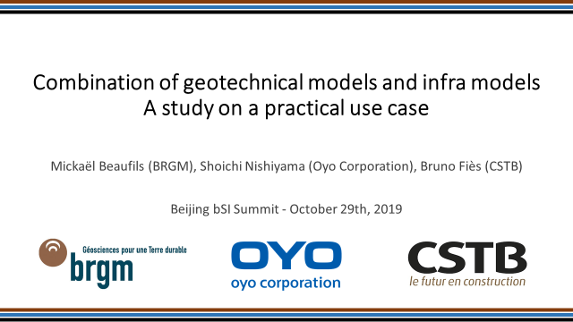
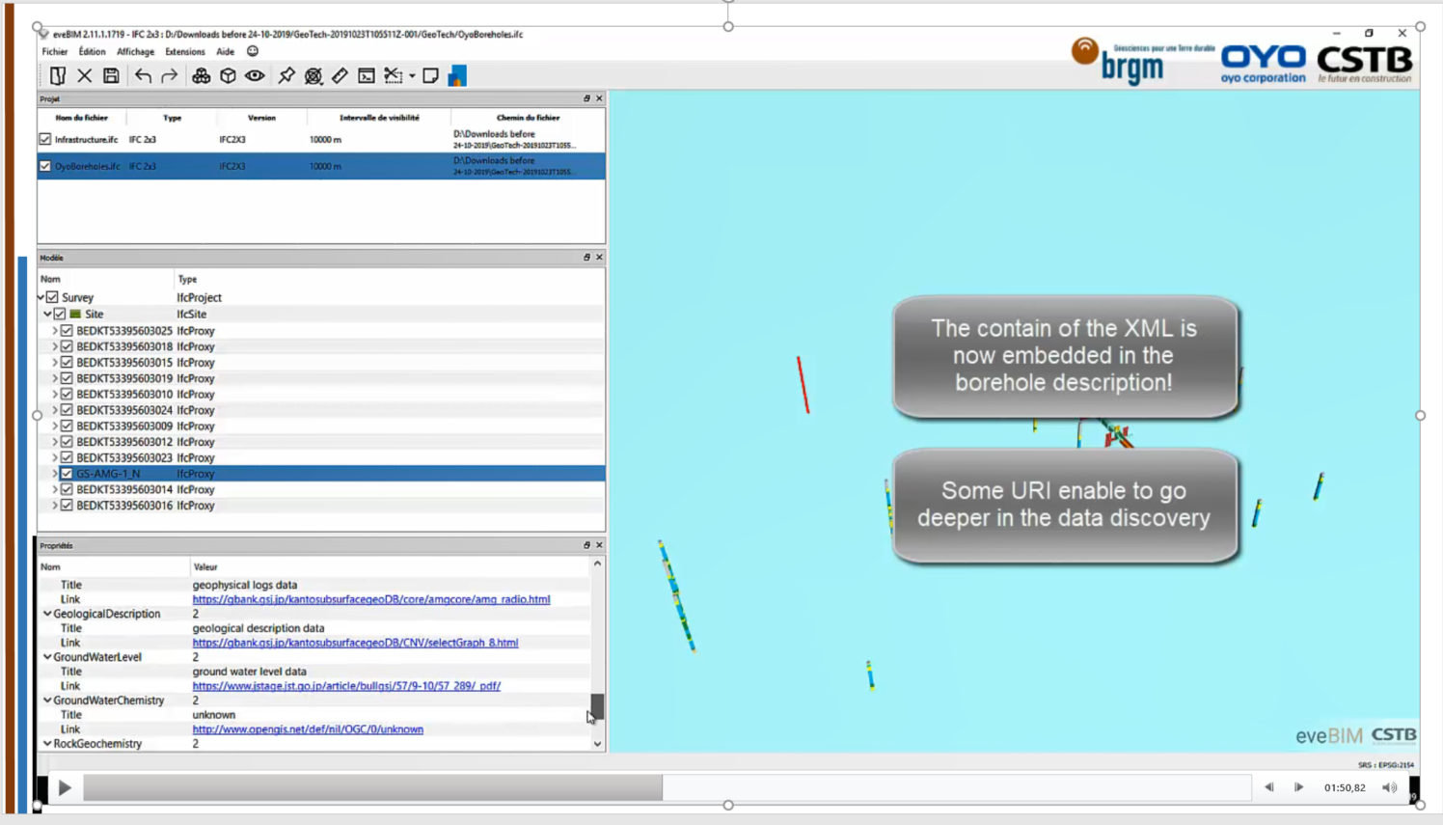
Back to Beijing bSI Summit Oct’19: Presentation by BRGM, OYO and CSTB
A demonstration of a “linked data approach”
Boreholes, Geologic Units and model description came from the EPOS data model (extension of OGC GeoSciML data model)
Descriptions were made available through OGC API
IFC was used as a container to provide 3D representations

Slide 8
Application to GeoScience
BIM Software A
BIM Software B
IFC file
Georeferencing
Geometries
Properties
Uncertainties & risks
Data
Data
API
Vocabulary registry
API
Access non BIM oriented data
Geology DB
Hydrogeology DB
Geotechnical DB
Geology DB
Hydrogeology DB
Geotechnical DB
Geoscience vocab

Slide 9
Digital continuity for Geotechnics
Action plan
Common conceptual model between OGC GeoSciML & co. + IFC Tunnel – Geotechnics
OGC GeoSciML, GroundWaterML2 & co extensions
OGC & bSI White Paper: How to deal with geotechnical data
IFC OGC API connectors : extend IFC schema to handle « OGC API links »
OGC API Feature
OGC SensorThings API
Specifications to software vendors about expected behavior when dealing with OGC API connectors (resolve link)

Slide 10
Digital continuity for Geotechnics
Draft timeline
Summer 2021: Call for sponsor
Autumn 2021: Project presentation + Project kickoff
Project activity
Christmas 2022: Project end

